Slide 1
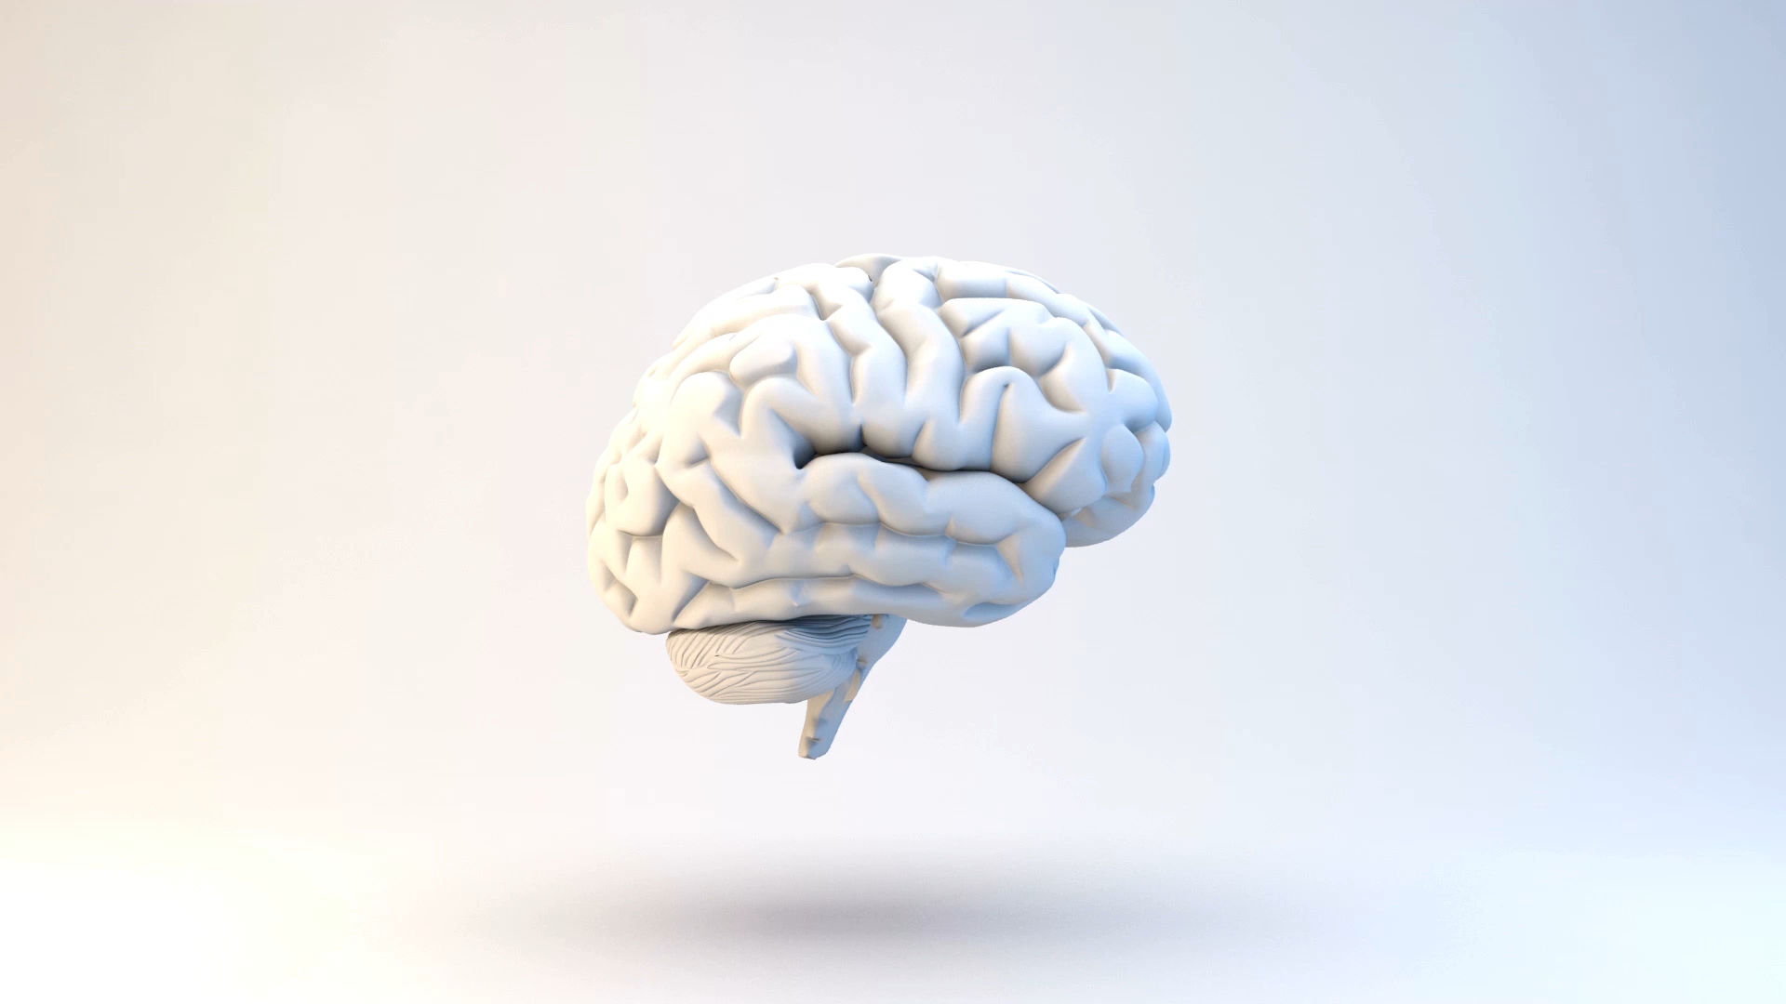
BRAIN AI

Slide 2
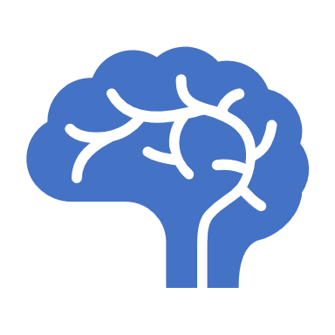
What is Brain AI and its Purpose?
Study and development of artificial intelligence system that aims to replicate or enhance human brain function and intelligence.
Purpose: To create machines that can perform tasks like humans such as natural Language processing, image, speech recognition and decision making.
Notes:
Intro: how brain functions and develop algorithms , a system that can perform tasks like human intelligence such as perception, problem solving. The development involves neuroscientist, computer scientist and engineers.
The ultimate purpose is to create a artificial system that can perform tasks like human or better than human to gain deep understanding of human brain.

Slide 3
Industries
Healthcare
Finance
Transportation
Education
Notes:
It can revolutionize many industries by improving efficiency, accuracy and decision making abilities.

Slide 4

How Brain AI functions?
By using artificial intelligence and machine learning algorithms. Especially neural networks to model and replicate the functions of human brain.
Notes:
A neural network consists of interconnected nodes or artificial neurons, each of which receives input , process it and passes it on to other neurons in the network. Through training, the network learns to recognize patterns and make predictions based on the input. Overall, Brain AI using AI and machine learning algorithms to make a another copy of human brain.

Slide 5
Applications of Brain AI
Natural language processing
Medical diagnosis
Fraud detection
Robotics
Computer Vision
Fraud detection
Self driving cars
Notes:
Natural Language processing: NLP is a way for computers to understand and work with human language, allowing them to perform tasks such as text classification, sentiment analysis and machine translation.
Medical diagnosis: Using application of AI and machine learning techniques to diagnose medical conditions through evaluation of patient data and symptoms. In simple words, to analyse patient data using computer technology to help doctors to make more accurate diagnoses.

Slide 6
Advantages of Brain AI
Improved accuracy
Increased efficiency
Reduced costs
Faster decision making.
Increased accesibility
Notes:
Brain AI Can analyse large amount of data quick than humans which leads to more accurate results.
It can automate repetitive and time consuming task faster and free humans from complex tasks.
It can reduce the need for humans labour in many sectors.
It can process data real time and make decision quickly and allow companies to response faster.
It can make information and services accessible to a wide range of users by integrating into many systems.

Slide 7
Disadvantages
Limitation of current Technology.
Job Loss
Privacy Concerns.
Lack of Trust
Security risks.
Unintended Consequences.
Notes:
Lets talk about limitation of current techhnology , how it affects : Brain AI includes incomplete understanding of the brain , high power of consumption , ethical concerns and limited data availability and technical difficulties which hinder its accurate implementation.
Job Loss: Brain AI has the potential to atomate many jobs , particulary those who are repetitive and can be performed easily by machines.. Such as low skill jobs that does not require advance technical skills customer service or telemarketing, financial analysis etc..
Privacy concern: Brain AI often requires access to large amount of personal data which could also be disadvantage.
Lack of trust: there may be a lack of trust in the decision making abilities of brain AI. Particularly the workings are not transparent or well understood.
Security risk: Brain AI can be vulnerable to hacking and cyber attacks can potentially cause harm to people.
Uninteded consequences: The complex nature of brain AI can lead negative impacts. It can be difficult to predict or reverse for many reasons such as complexity 1. Complexity : as it operates in dynamic and complex environment which can make it challenging to predict their behaviour and outcomes.

Slide 8
Future of Brain AI
Advancement in machine and deep learning.
Integration with IOT.
Improve health care
Enhance customer experience.
Increased automation
Advancement in NLP
Notes:
1.More improvements and new algorithms can be developed which can allow more accuracy of results.
2. Integration with IOT can alllow real time analysis of data from many sources and devices.
3.Improve patient outcomes and enable more accurate diagnose.
4. It can allow more human like interactions between human and computers.
Overall, it can improve our daily live in many ways. Its ability to analyse large amount of data accurately and quickly and provide personal reccomendations makes it a poweful tool.
As the field of brain AI continue to grow and evolve, it will play significant role in shaping the future . It will be exciting to see how it continues to impact our world in the coming years.

Slide 9

Thank you

